Slide 1


Computech Corporation: Advanced Job and Candidate Application
Design Specification
Simul Kadakia, Wesley Trescott, Gagandeep Singh
3/10/2015

Slide 2
Contents
Introduction
Assumptions, Constraints, and Standards
Architecture Design
System Design

Slide 3
Introduction
1.

Slide 4
Purpose
Provide a detailed description of the
Design framework
Software and hardware architecture
Security and Communication architecture
Database Design
Use cases
Sequence Diagrams

Slide 5
Definitions, Acronyms, & Abbreviations
• EJCA - Enhanced Job and Candidate Application
• User – Job seeker who uses the application
• Admin – Admin/administrator who manages the users
• Admin portal - Part of the web application that provides special facilities to Admin
• Front End - The part of the application the user interacts with
• Back End – The part of application that manages data and is managed by developers.
• UI – User Interface which is the front end of the application
• Server –Machine that will host the web application as well as database.

Slide 6
Constraints
UI based on the type of device used
Required modern internet browser such as Safari, Google Chrome, or Internet Explorer.
Assumptions
Internet connection with enough bandwidth (about 1 to 2 mbps)
Internet browser with an up to date JavaScript engine and support for HTTP cookies to remember returning user logins

Slide 7
Architecture Design
3.

Slide 8
Hardware Architecture
Webserver (Owned by Computech)
Windows Server 2008 R2 Standard
16 GB of RAM
Runs the following software:
Microsoft IIS 7.5 Webserver
Microsoft SQL Server 2008 R2 Database
User Machine
Any PC with latest version of Google Chrome,

Slide 9
Software Architecture

Slide 10
Security Architecture

Slide 11
Communication Architecture

Slide 12
system Design
4.

Slide 13
System design
Use cases:
Register
Normal Flow: ☺

Slide 14
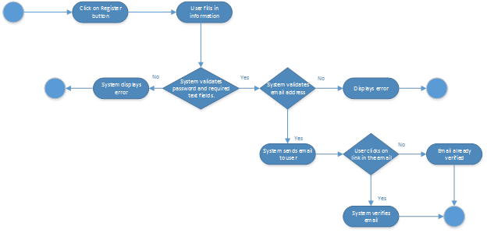
Use case – register - exception

Slide 15
Use case – Login- normal flow ☺

Slide 16
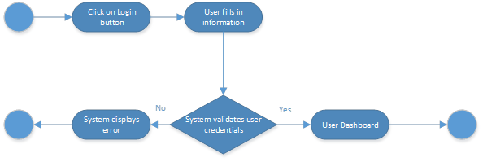
Use case – Login- EXception

Slide 17
Use case – Apply – normal flow ☺

Slide 18
Use case – Apply – exception

Slide 19
Database design

